Slide 1










Lore Trail
A digital library of global folklore, myths, and traditions.

Slide 2
PROBLEM STATEMENT

Slide 3
USER RESEARCH
Understand how users discover, read, and enjoy myths/legends and what would motivate them to save, share, or create stories.

Slide 4
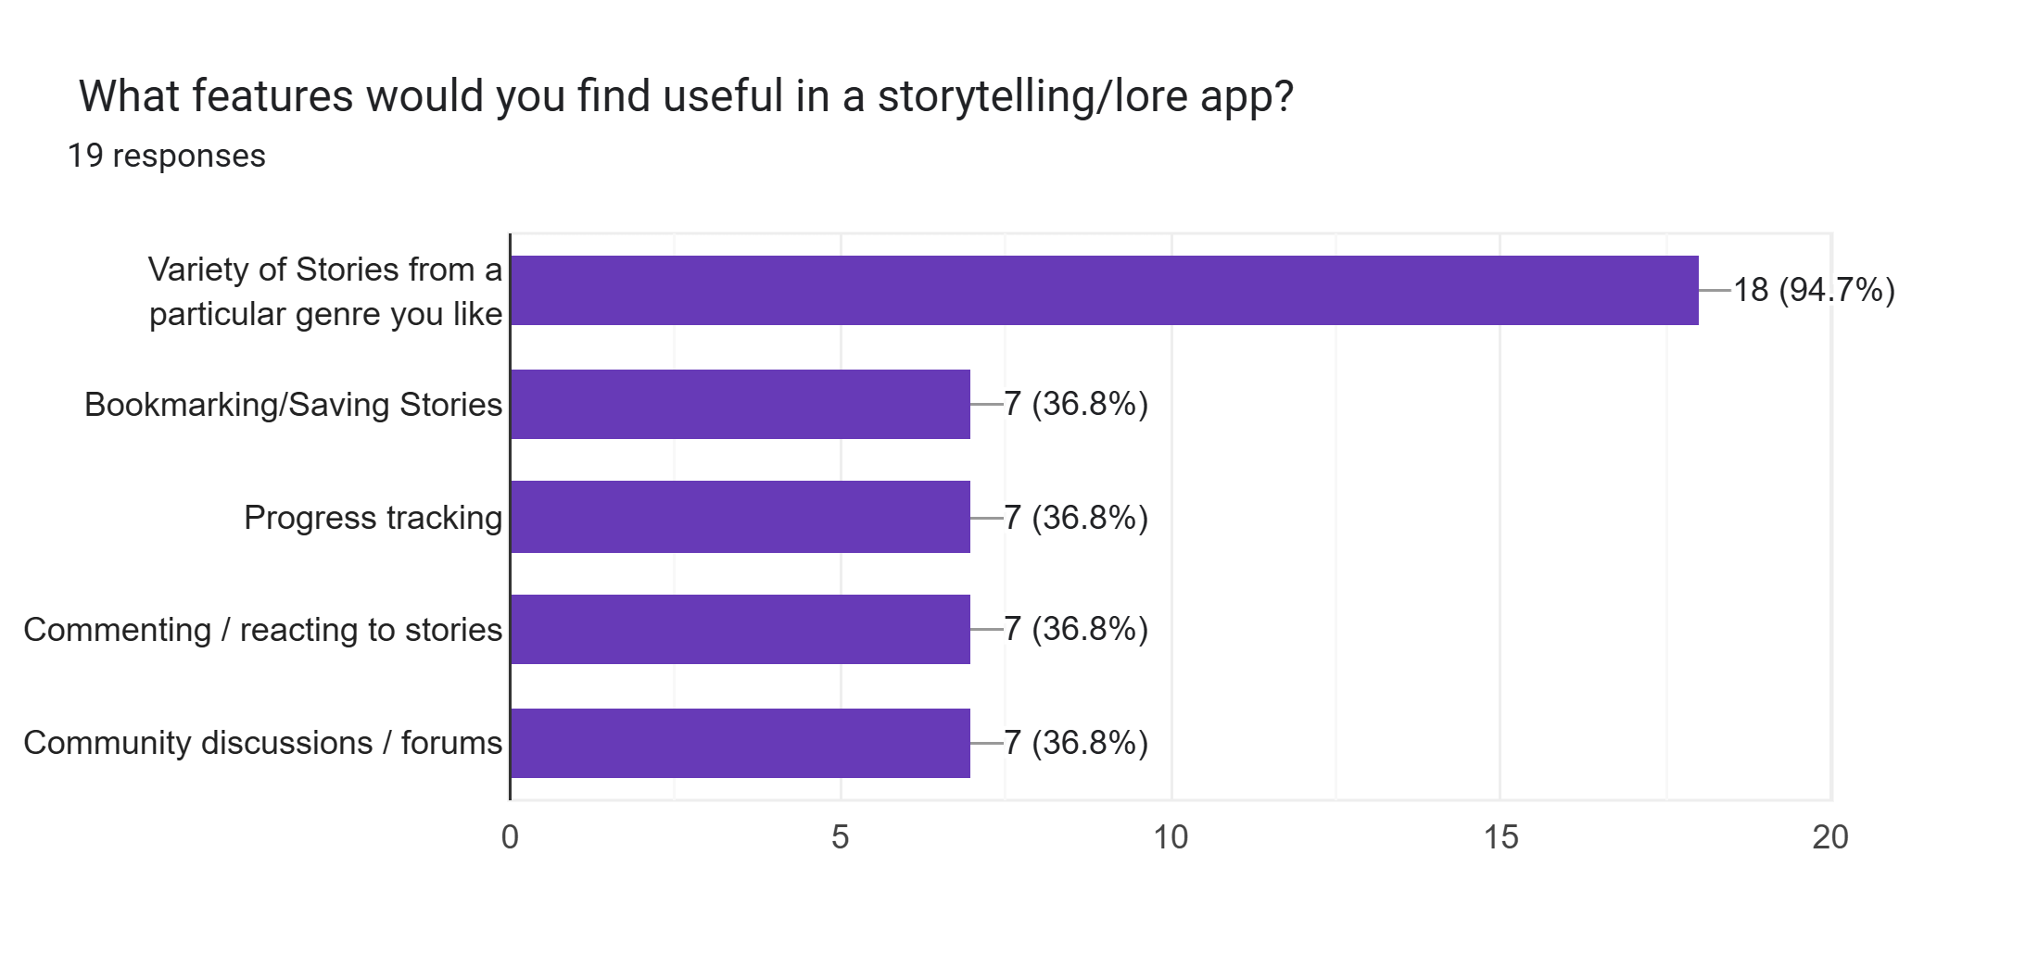
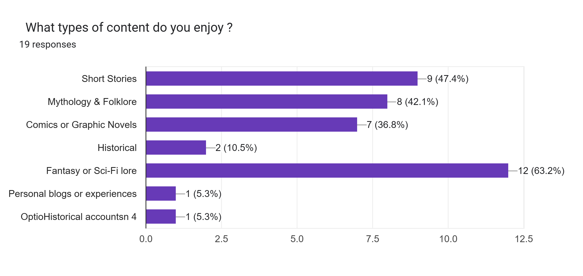
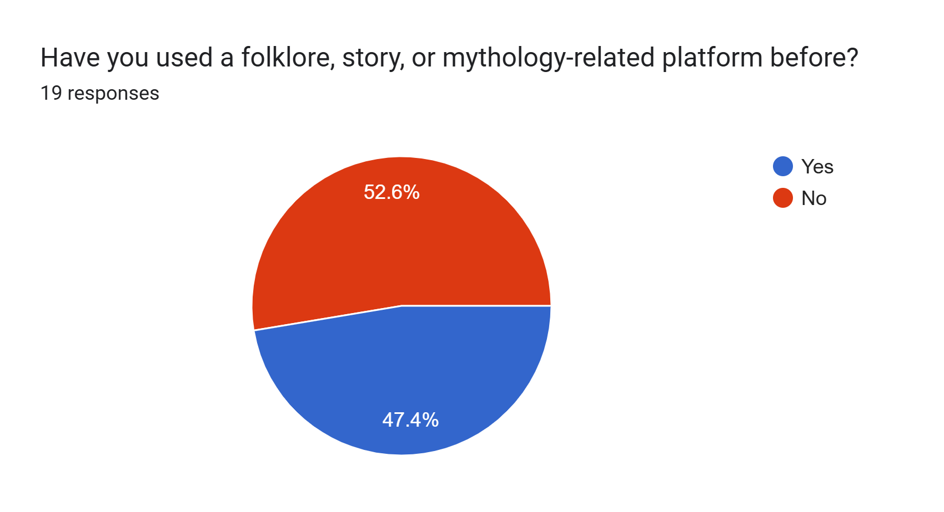
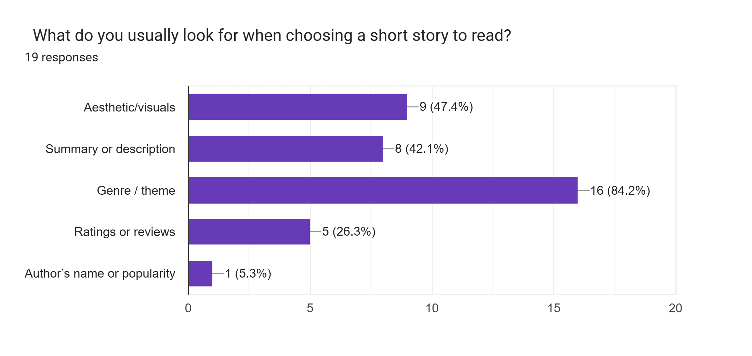
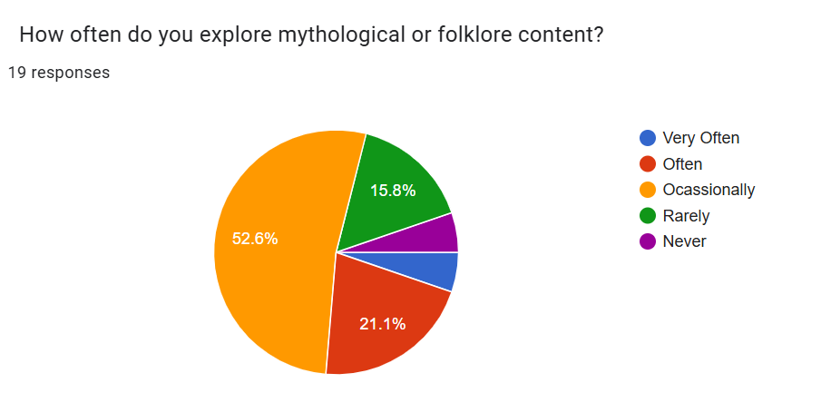
USER
RESEARCH

Slide 5
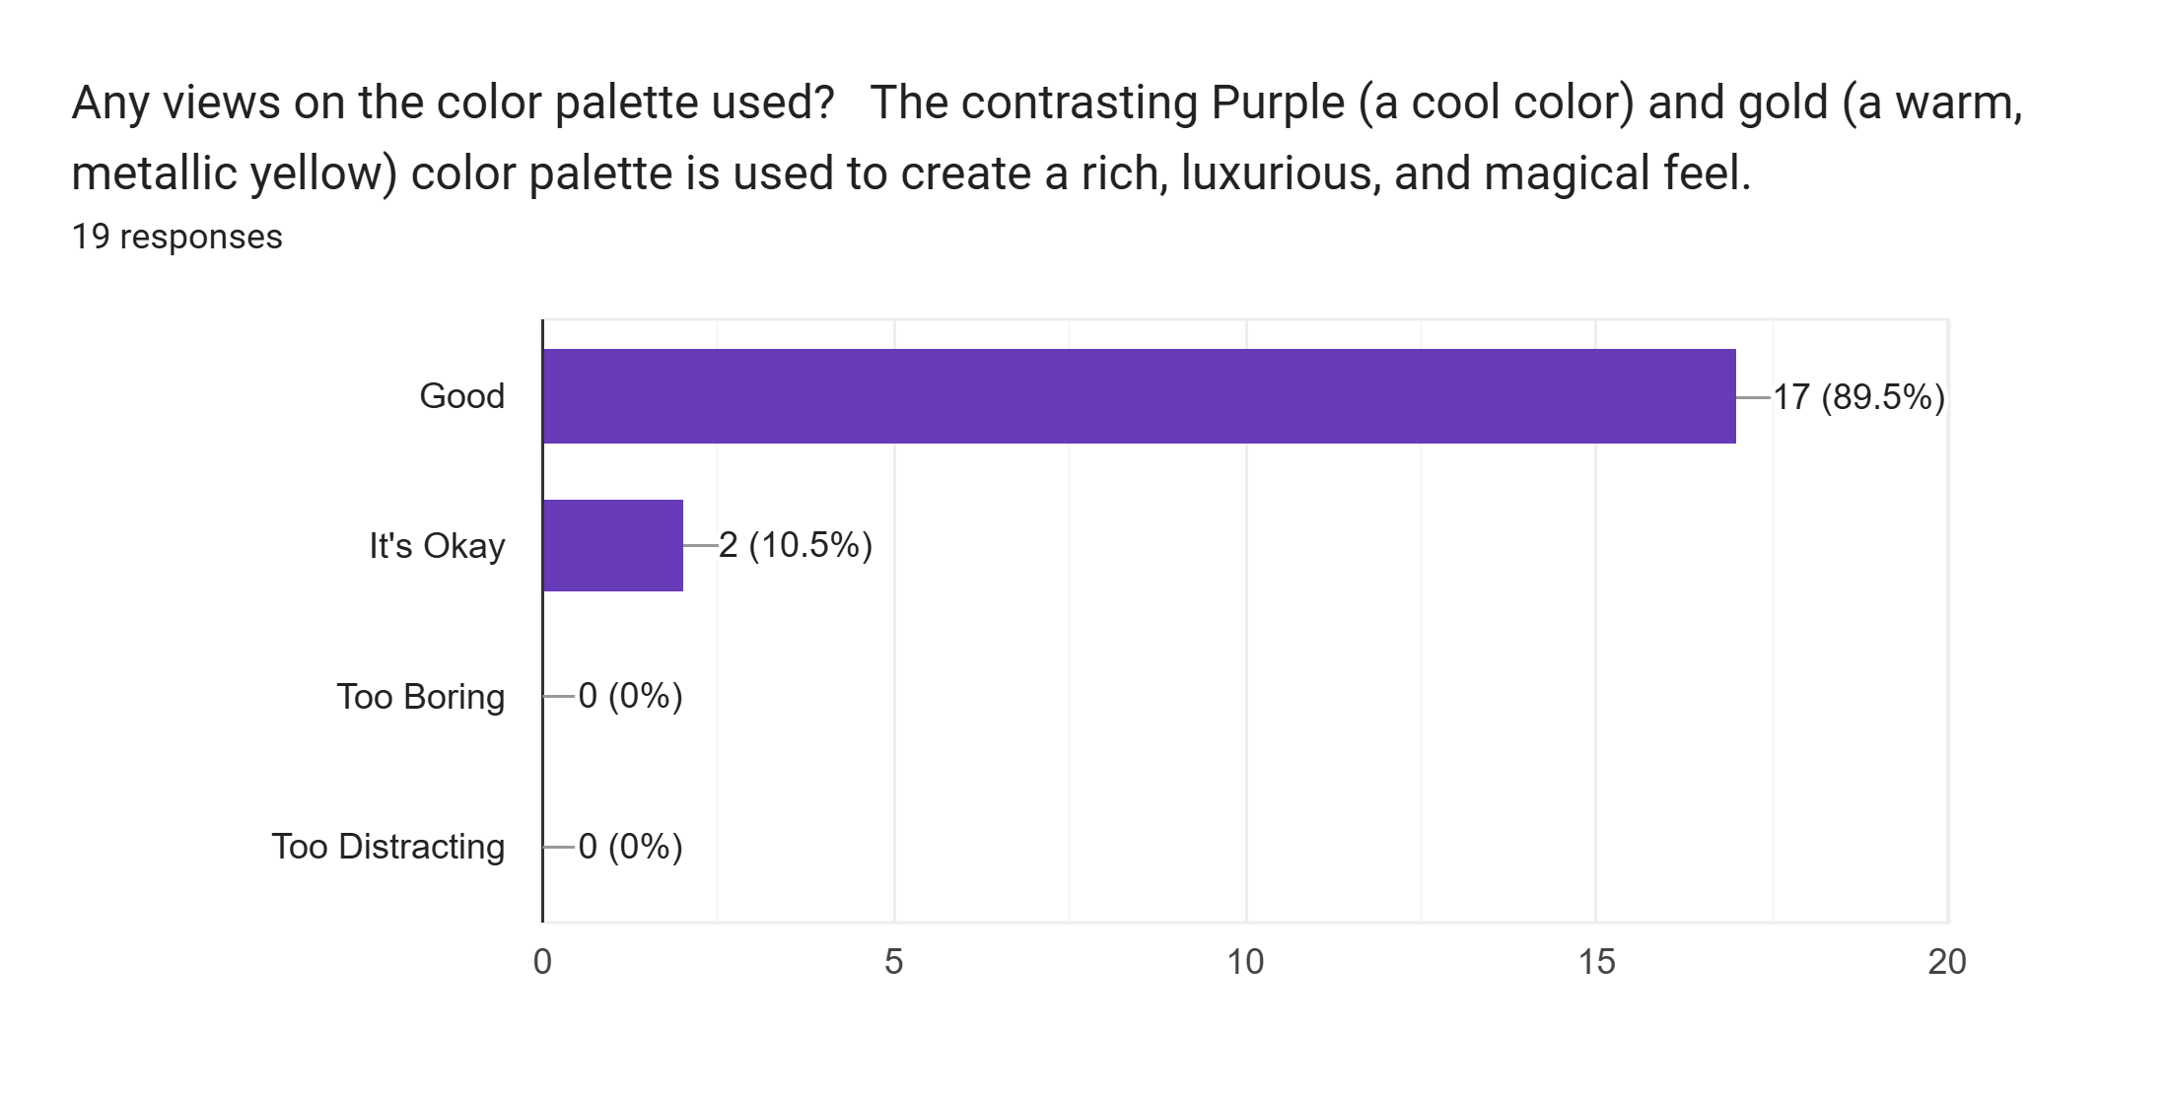
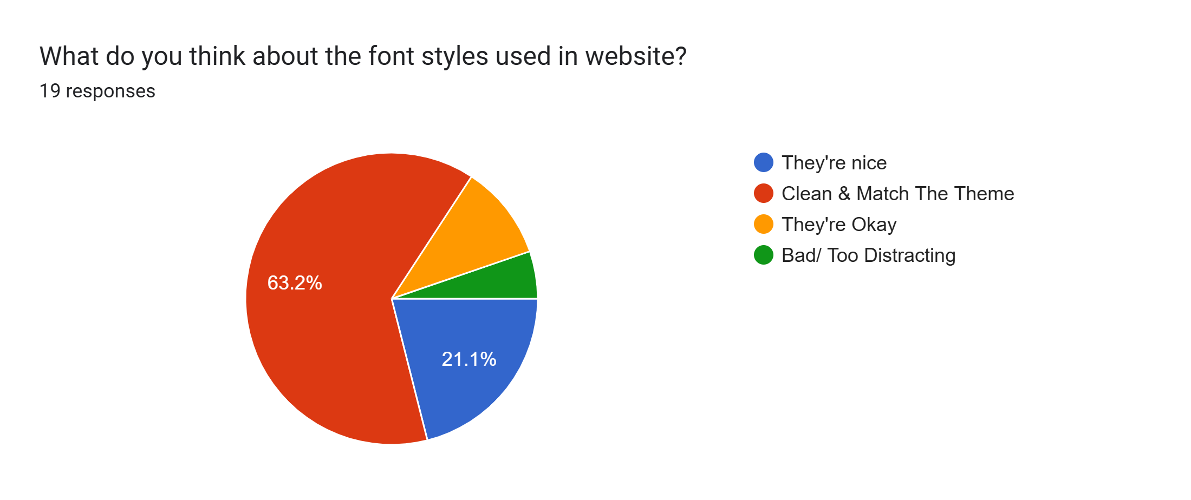
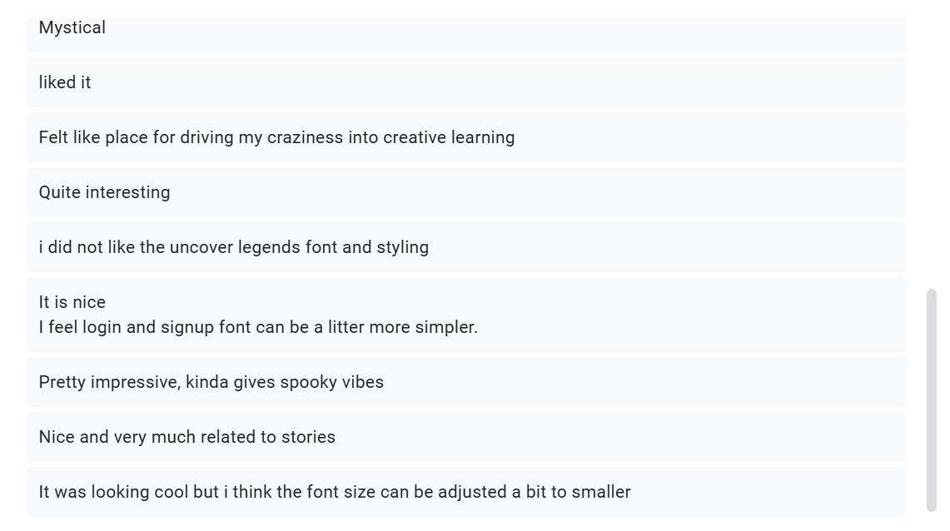
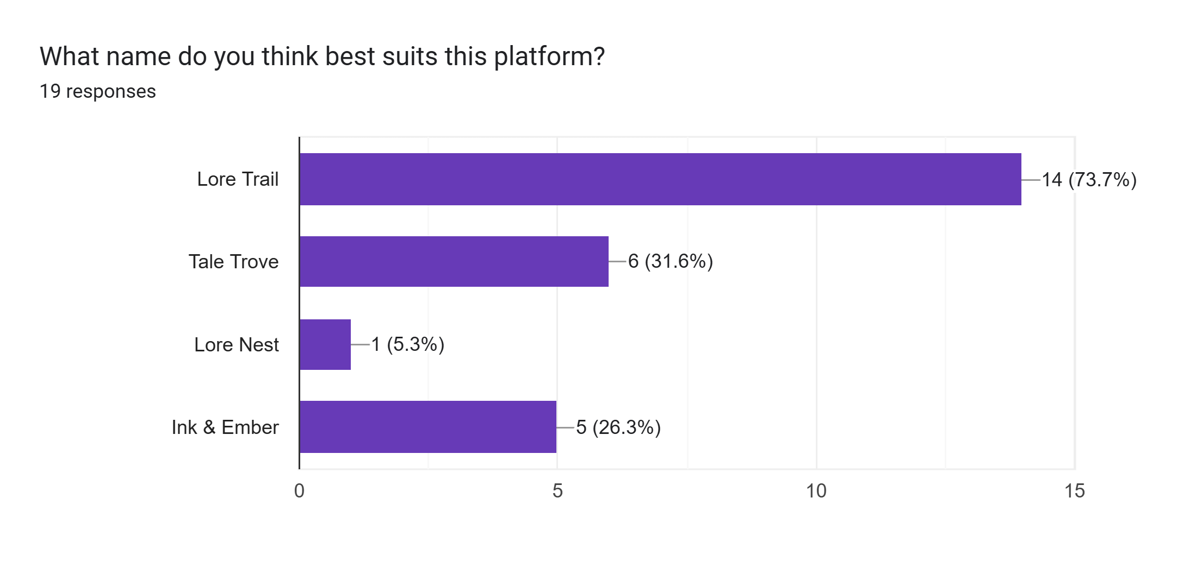
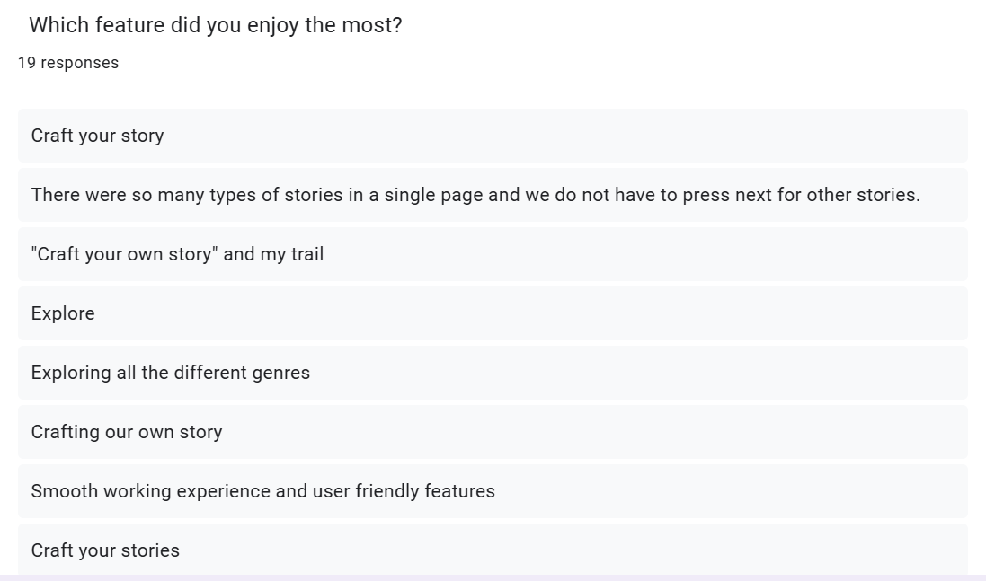
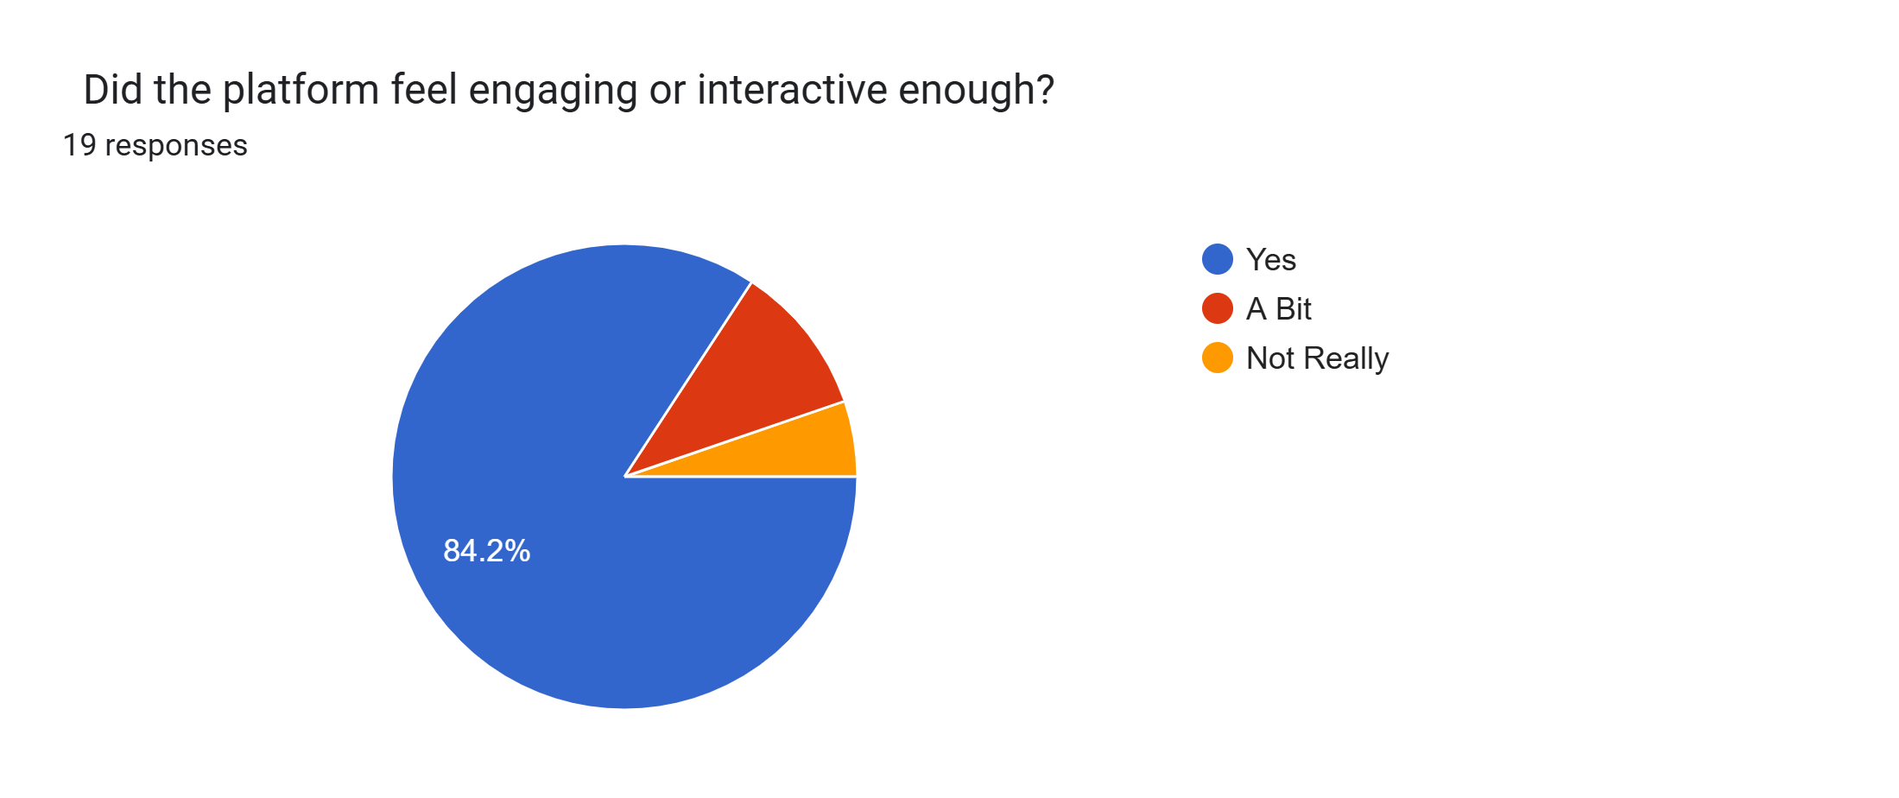
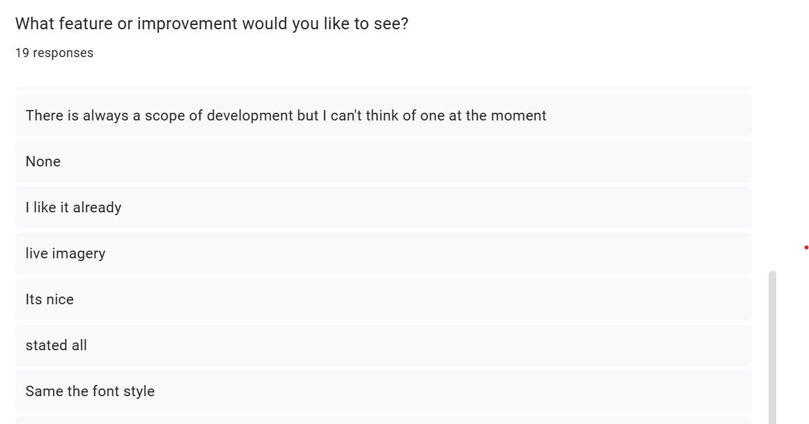
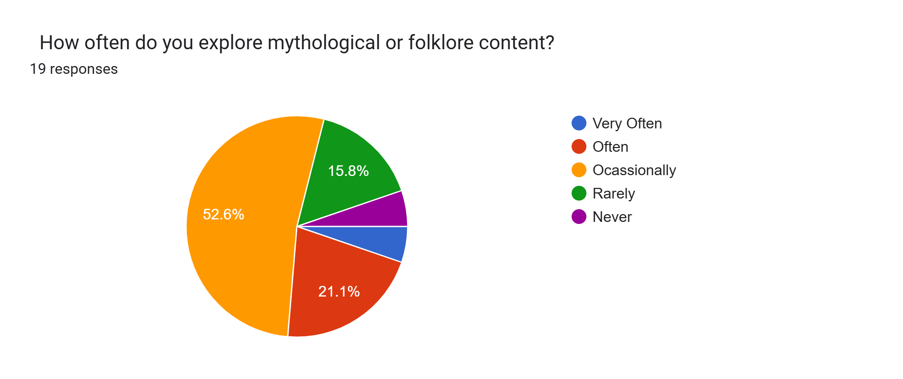
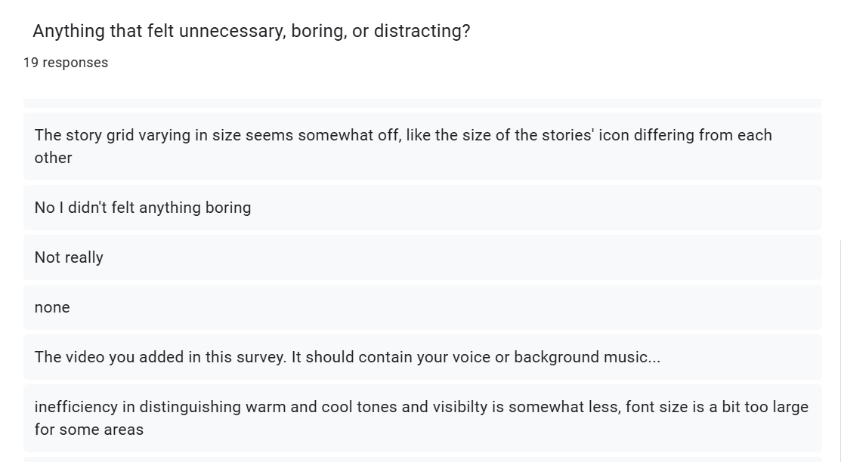
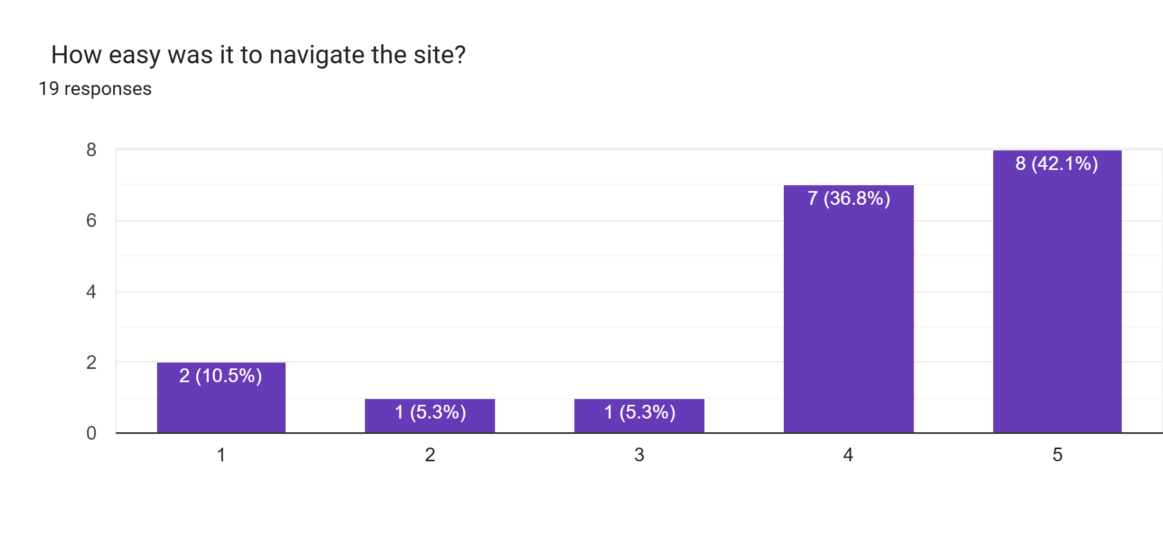
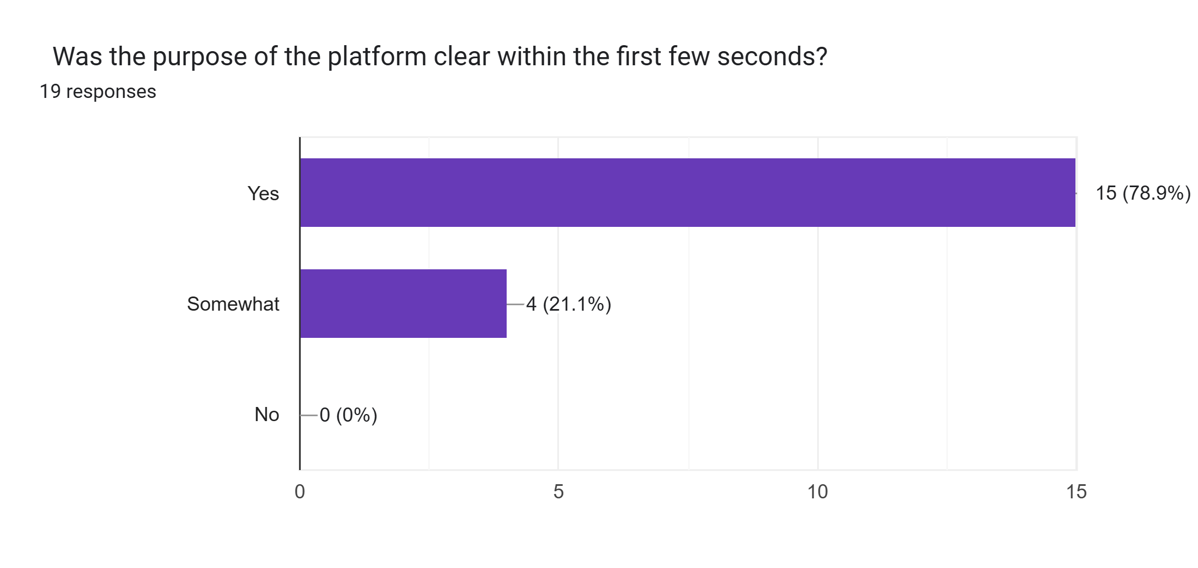
Usability
testing

Slide 6
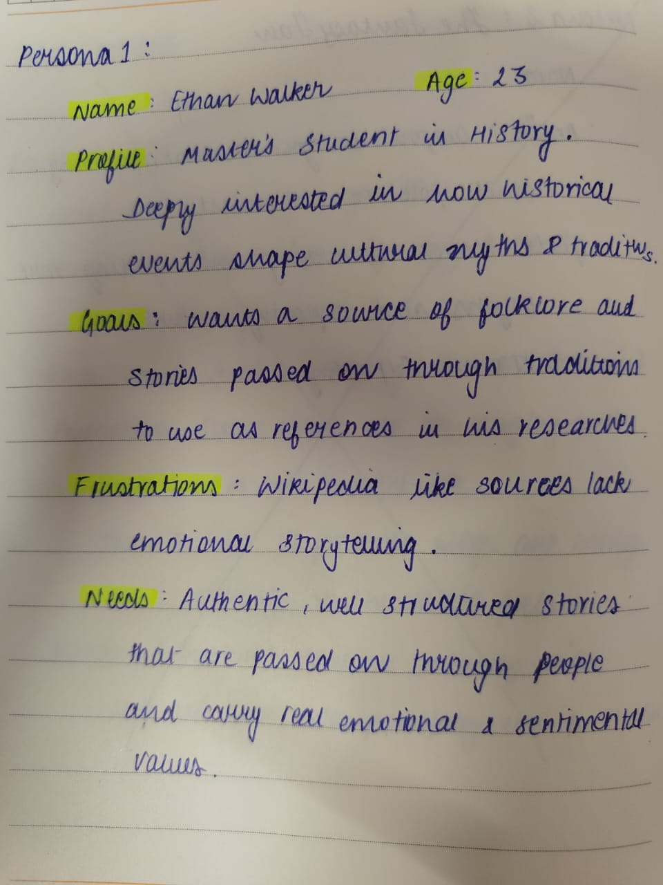
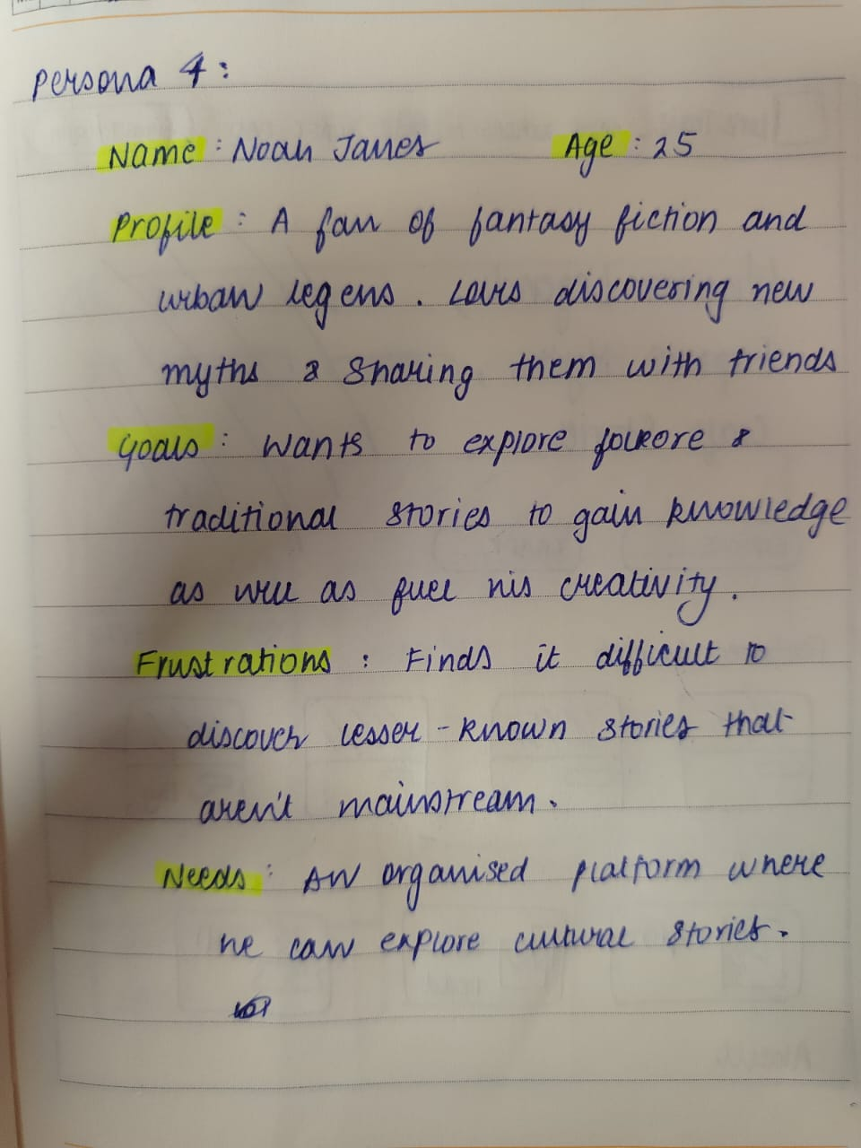
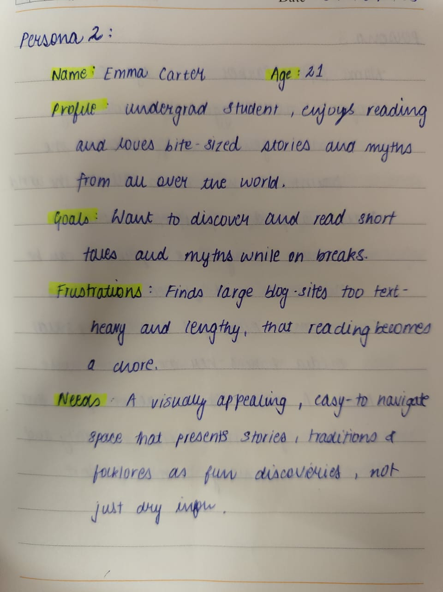
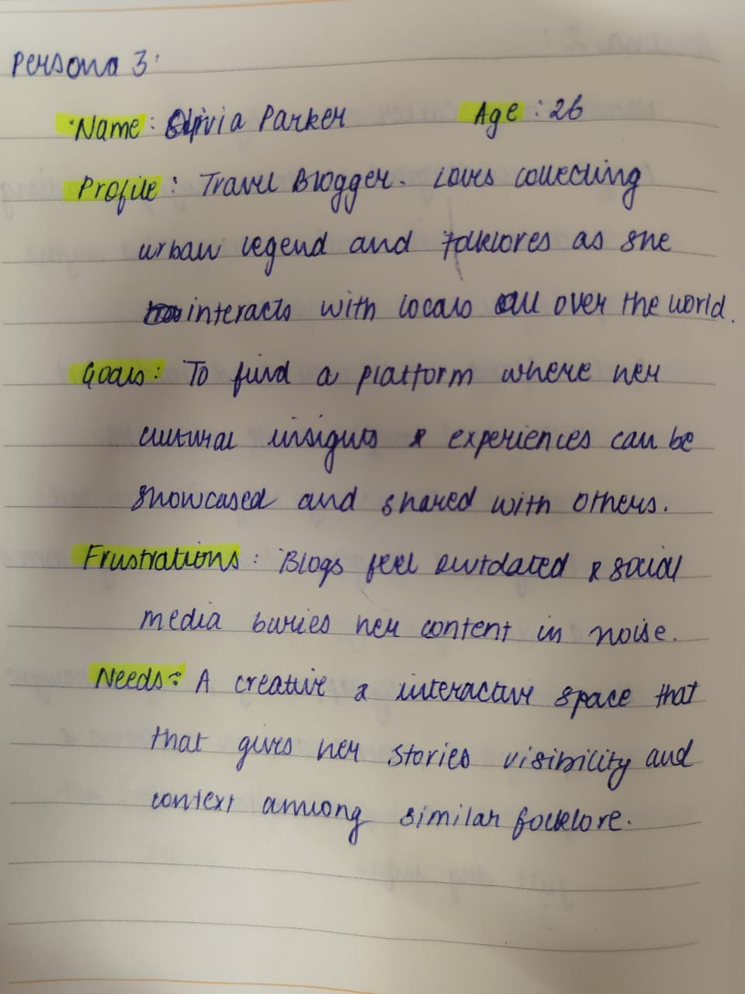
User personas

Slide 7
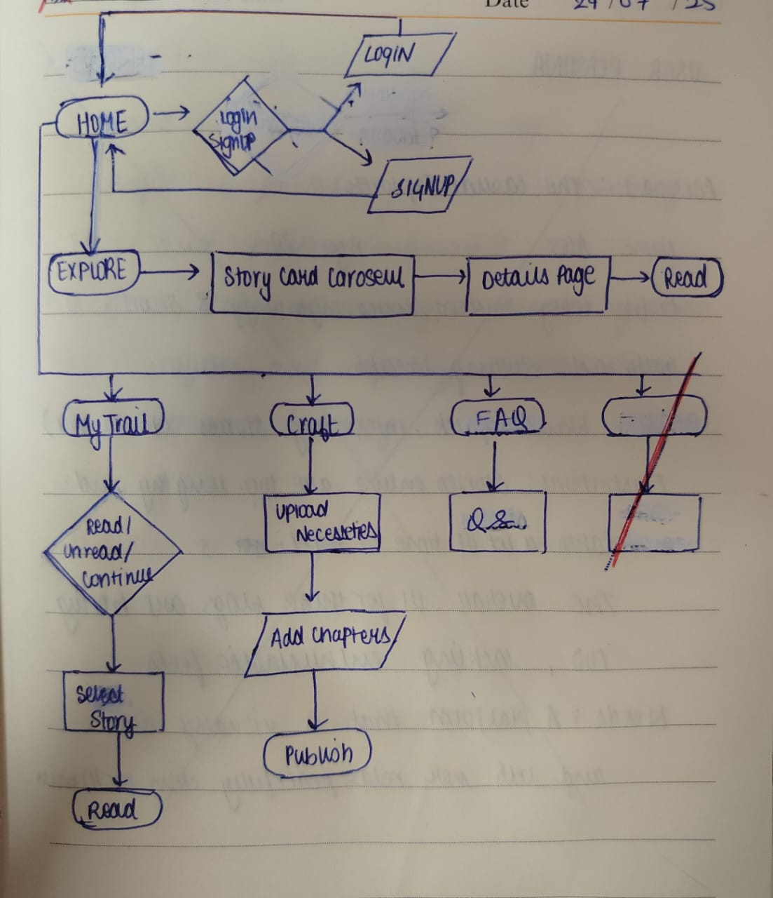
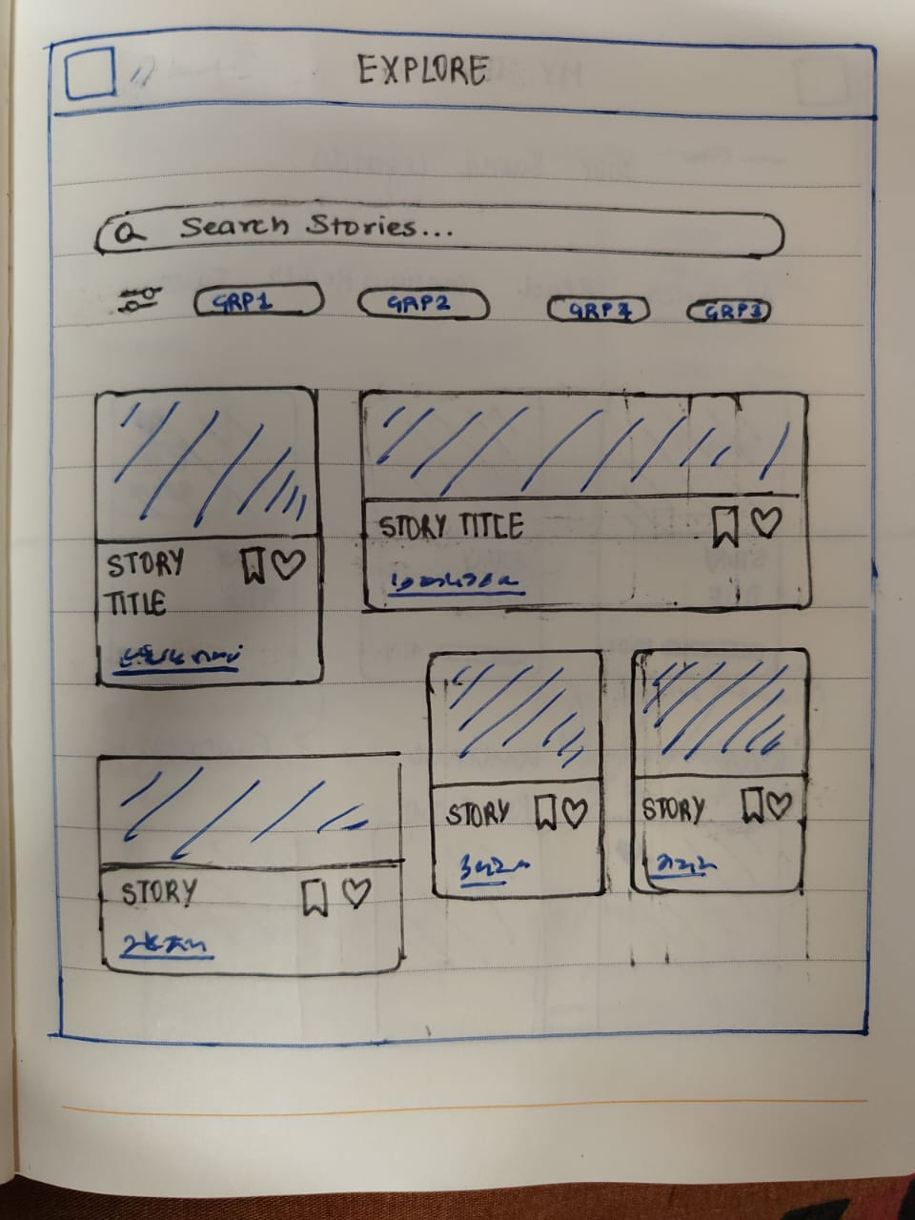
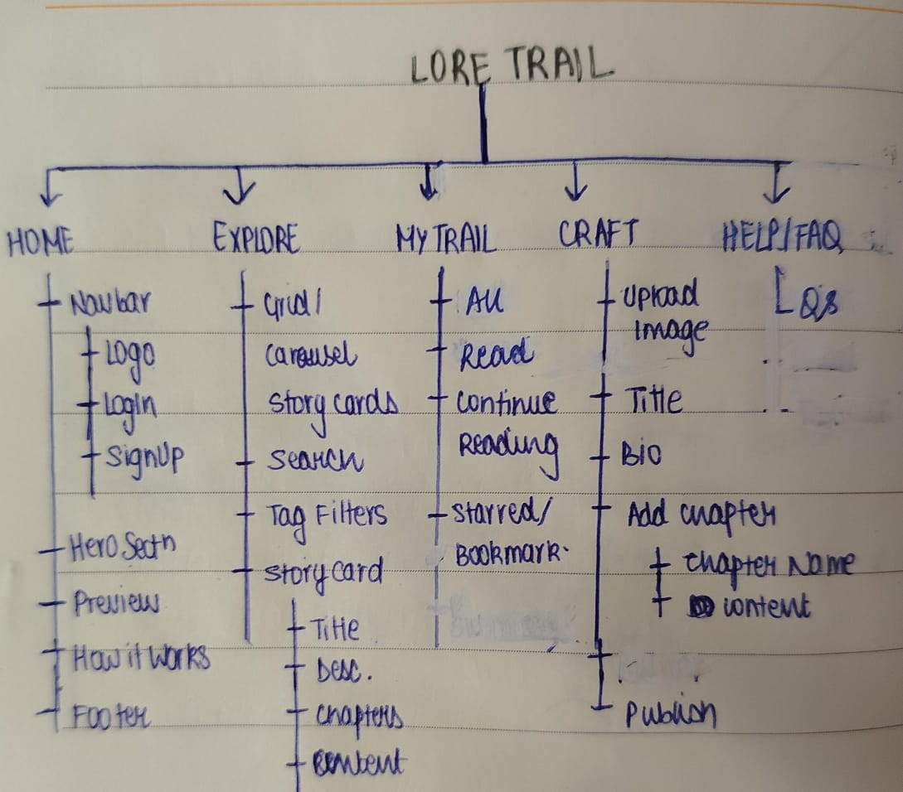
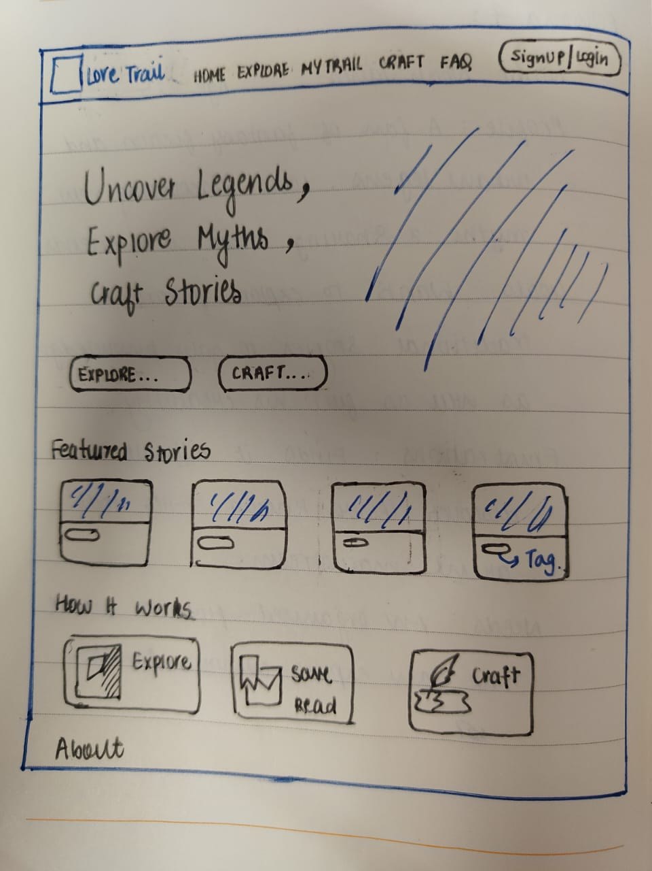
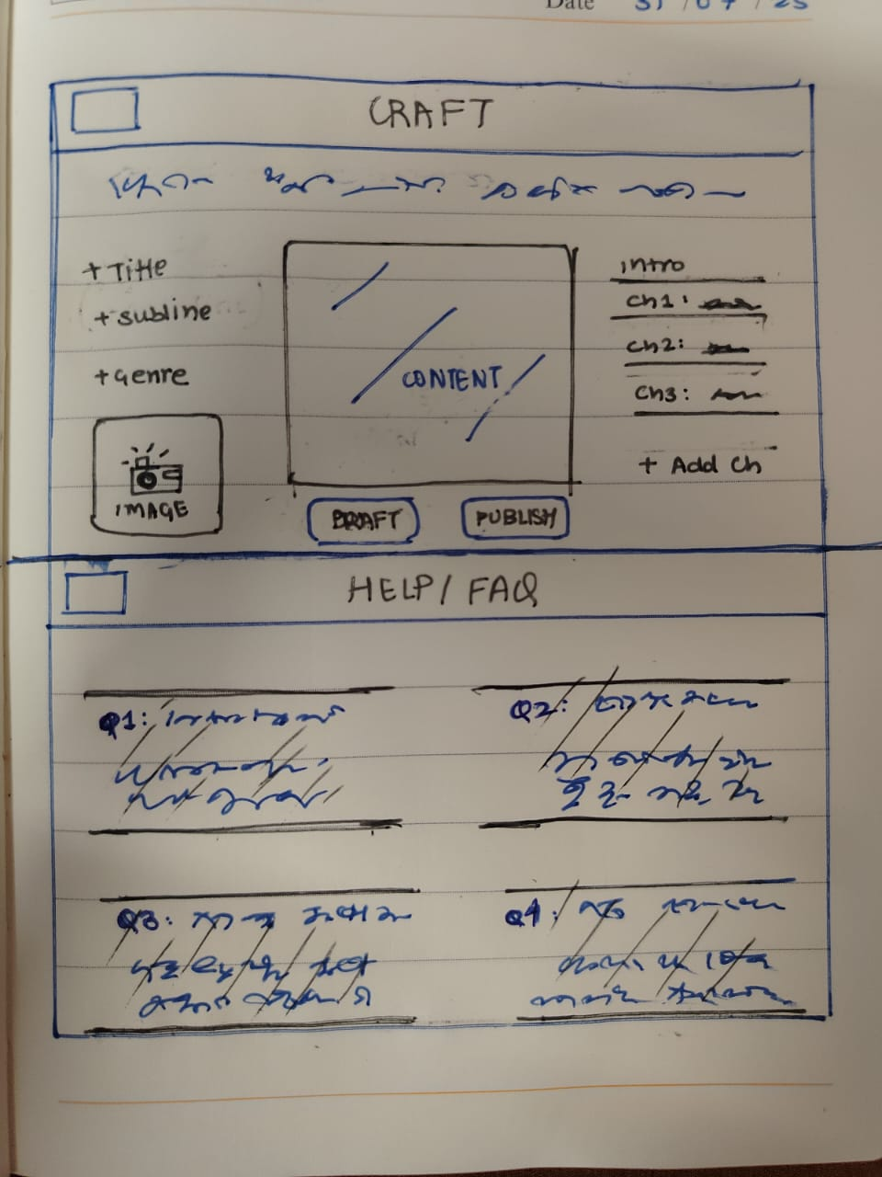
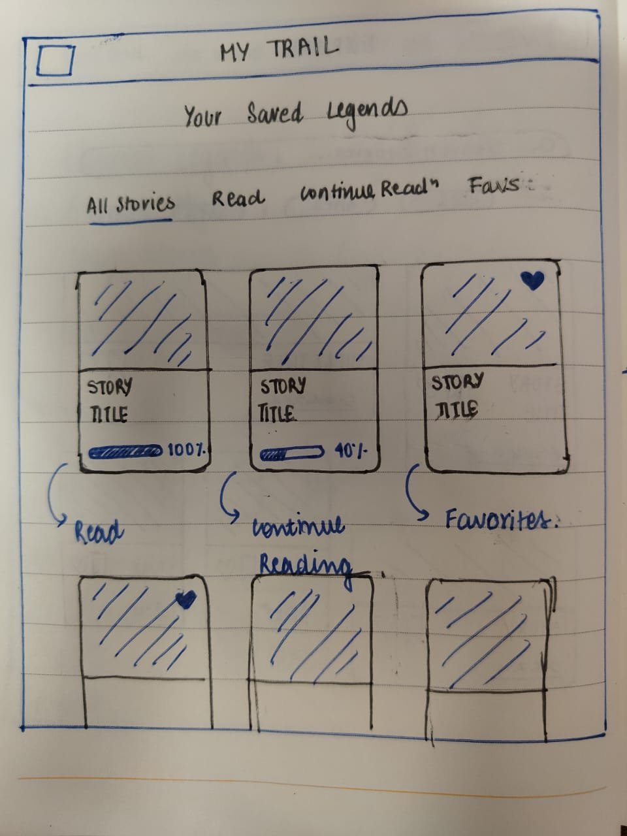
UX PROCESS & INFORMATION ARCHITECT
Ux process & information architect
USER FLOW. SITE MAP.

Slide 8
USER FLOW. SITE MAP.

Slide 9
USER RESEARCH
Understand how users discover, read, and enjoy myths/legends and what would motivate them to save, share, or create stories.

Slide 10
WIREFRAME & PROTOTYPING
Sketches. Wireframes.

Slide 11
WIREFRAME & PROTOTYPING

Slide 12
1. Problem Definition & Research (5 Marks)
Compulsory:
● Problem Statement: What is the issue you're solving?
● Background: Why is this problem important?
● User Persona (at least 1)
Optional (but HIGHLY RECOMMENDED):
● Survey or interview insights
● Key pain points or trends from research

Slide 13
2. UX Process & Information Architecture (10 Marks)
Must Include:
● User Flow diagrams
(How does the user navigate through your product?)
● Show at least one major flow end-to-end (login > use feature > logout)

Slide 14
3. Wireframing & Prototyping (15 Marks)
Low-Fidelity Wireframes (5 marks):
● Sketches or basic grayscale wireframes
● Can be hand-drawn or digital
High-Fidelity Wireframes (5 marks):
● Clean, colored UI screens in Figma
● Include at least 6–10 key screens (Web / App)
Clickable Prototype (5 marks):
● Interactive links between screens
● Cover core flows (like login → main page → action → confirmation)

Slide 15
4. UI Design & Visual Consistency (10 Marks)
Must Include:
● Design system: colors, typography, spacing, buttons, cards
● Proper use of contrast and hierarchy
● Consistent layout and responsive design
● Visual balance and intuitive icons/images
Bonus Tips:
● Don’t go overboard with color
● Stick to 2–3 fonts max

Slide 16
5. Responsive & Interactive Design
Must Include:
● Hover states, button animations, toast notifications
● Mobile + Desktop responsive UI
● Feedback messages (success/error)

Slide 17
6. Usability Testing & Refinement (Optional but helps with
full score)
If Included:
● Mention how many users tested it
● What tasks they performed
● Key feedback received
● Improvements made based on feedback
● Before/after screenshots help! A google form with graphs and charts as result would
work.

Slide 18
7. Final Submission Requirements (10 Marks)
You MUST Submit:
● Figma file (includes wireframes, UI, prototype)
● PPT
● Case study or documentation with the following sections:
○ Problem Statement
○ User Persona
○ User Flow
○ Wireframes
○ UI Screens
○ Prototype Link
○ Usability Testing (optional but boosts score)
○ Key Design Decisions

